Slide 1
ActiveRecord
Associations & Validations

Slide 2
What is ActiveRecord?
“Active Record” is a design pattern.
ActiveRecord is a library.
It brings Object Oriented Programming into your project’s database.
The ActiveRecord library is really big.

Slide 3
ActiveRecord
Sinatra
72,824
16,299
659
140
According to CLOC
According to CLOC
Lines of Ruby Code
Lines of Ruby Code
Ruby Code Files
Ruby Code Files

Slide 4
Magic is not inherently
a bad word.
Source: ActiveRecord README

Slide 5

Associations
Creating and utilizing connections between two (or more) ActiveRecord models

Slide 6
ActiveRecord - Associations
Create relationships between Models.
Types of associations...
has_many
belongs_to
has_many :through
has_one
has_one :through
has_and_belongs_to_many

Slide 7
ActiveRecord - Associations
Create relationships between Models.
Types of associations...
has_many
belongs_to
has_many :through
has_one
has_one :through
has_and_belongs_to_many

Slide 8
One-To-Many Relationships
Model | Person | Book
Question | Can a Person have many Books? | Can a Book have many People?
Answer | Yes | No (when considering ownership)
One or Many? | One | Many
Has foreign key? | No | Yes
Person
Book

Slide 9
One-To-Many Relationships
# app/models/book.rb
class Book < ActiveRecord::Base
end
# db/migrate/YYYYMMDDHHMMSS_create_books.rb class CreateBooks < ActiveRecord::Migration def change create_table :books do |table| table.string :title, null: false
table.integer :person_id, null: false end end end

Slide 10
One-To-Many Relationships
Without AR associations:
person = Person.create(name: "Richard")
# creating an associated object
book = Book.create(title: "Ready Player One", person_id: person.id)
# finding a book’s owner
Person.find(book.person_id)
# finding a person’s books
Book.where(person_id: person.id)

Slide 11
One-To-Many Relationships
# app/models/person.rb
class Person < ActiveRecord::Base
has_many :books
end
# app/models/book.rb
class Book < ActiveRecord::Base
belongs_to :person
end

Slide 12
One-To-Many Relationships
With AR associations:
person = Person.create(name: "Richard")
# creating an associated object
book = Book.create(title: "Ready Player One", person: person)
# finding a book’s owner
book.person
# finding a person’s books
person.books

Slide 13
Many-To-Many Relationships
Model | Book | Authors
Question | Can a Book have many Authors? | Can an Author have many Books?
Answer | Yes | Yes
One or Many? | Many | Many
Book
Author

Slide 14

Join Model
There will be two one-to-many relationships.
Both models will have a one-to-many relationship with the model which joins them.

Slide 15
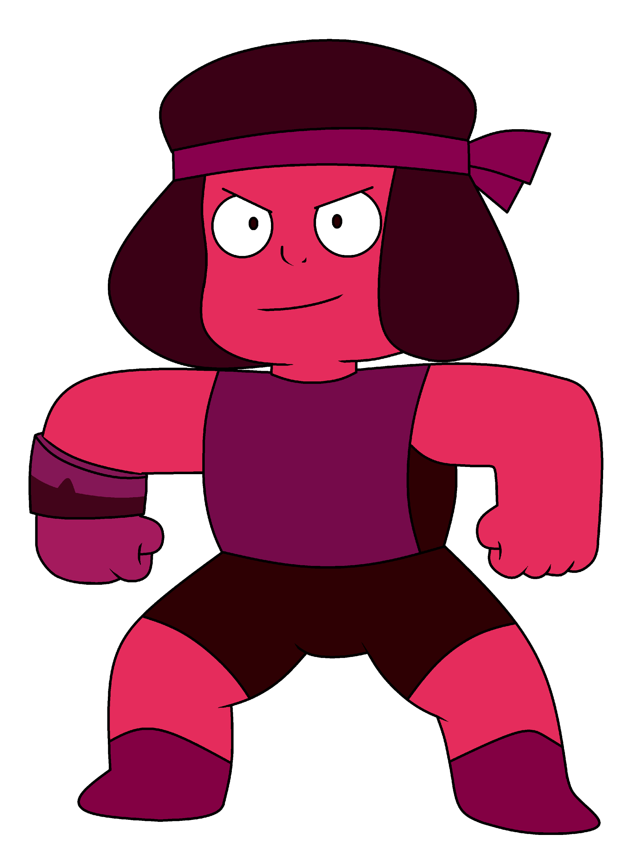
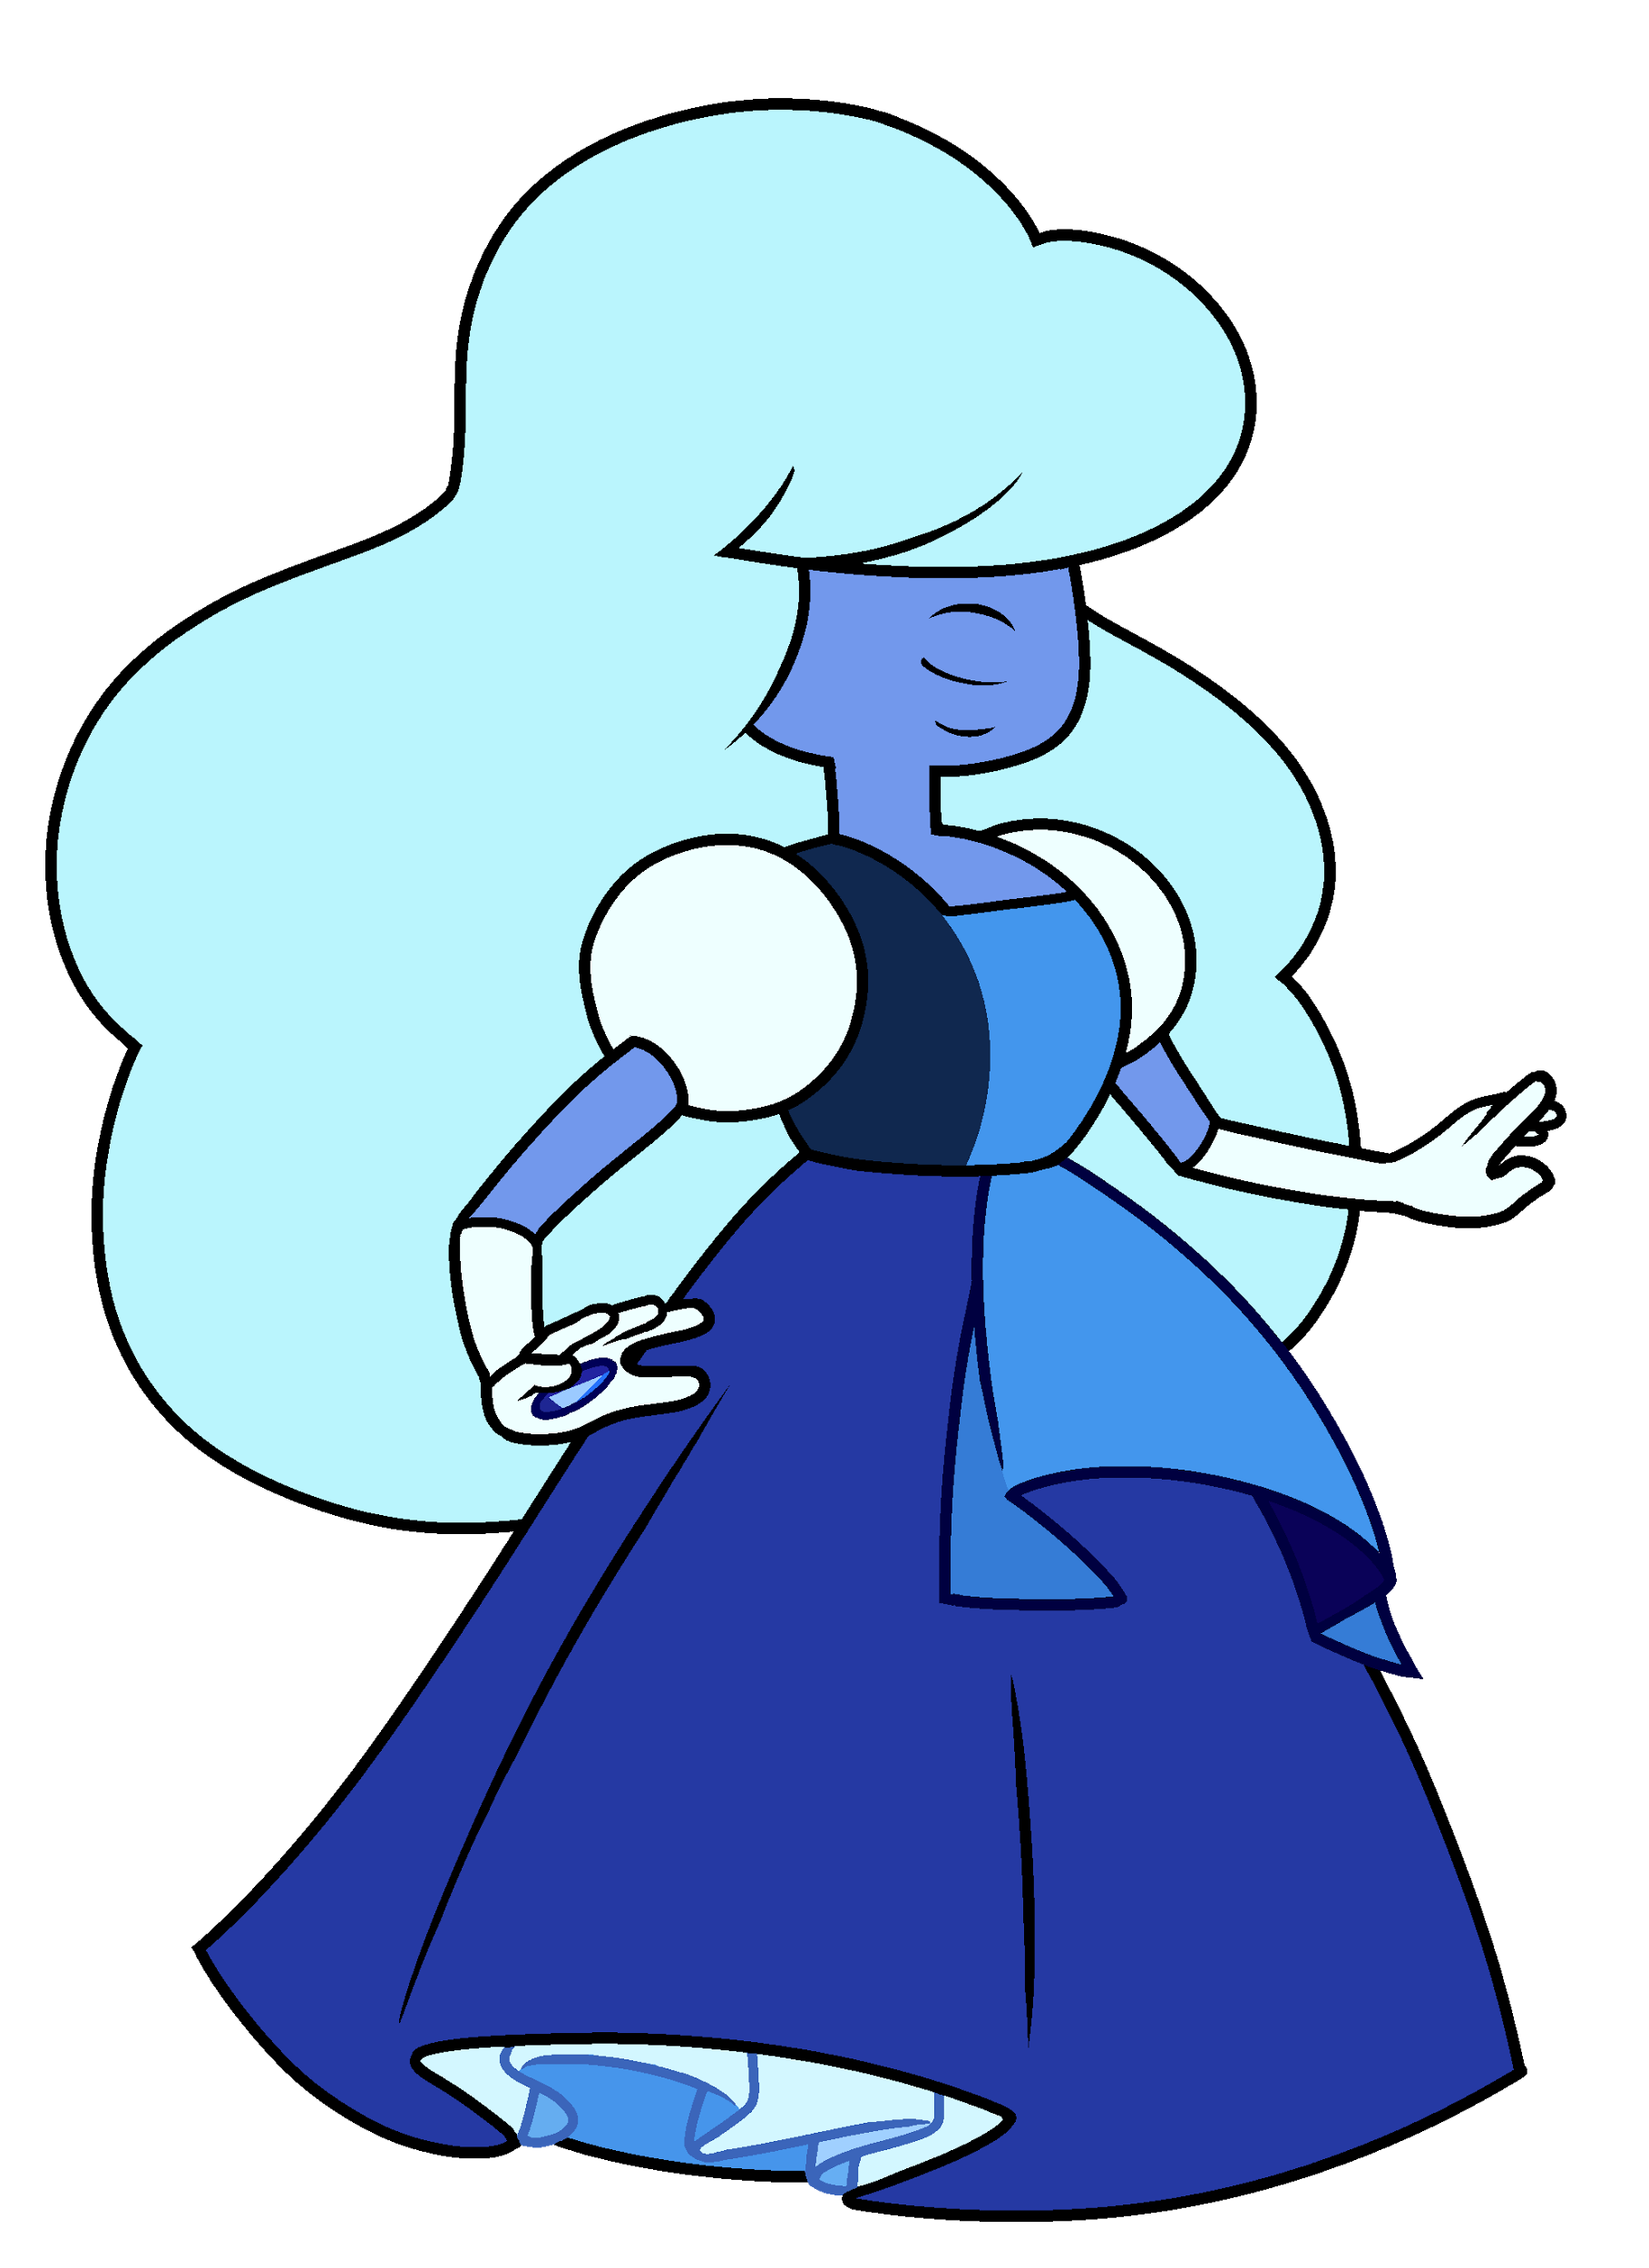
Many-To-Many Relationships
Book
BookAuthor
Author
books
id | name
1 | The Martian
2 | The Hundred Thousand Kingdoms
3 | The Fifth Season
4 | The Rails 4 Way
books_authors
id | book_id | author_id
1 | 1 | 1
2 | 2 | 2
3 | 3 | 2
4 | 4 | 3
5 | 4 | 4
authors
id | name
1 | Andy Weir
2 | N. K. Jemisin
3 | Obie Fernandez
4 | Kevin Faustino

Slide 16
Many-To-Many Relationships
Book
Author
BookAuthor
# app/models/book.rb
class Book < ActiveRecord::Base
has_many :book_authors
end
# app/models/author.rb
class Author < ActiveRecord::Base
has_many :book_authors
end
# app/models/book_author.rb
class BookAuthor < ActiveRecord::Base
belongs_to :book
belongs_to :author
end

Slide 17
Many-To-Many Relationships
Book
Author
BookAuthor
# app/models/book.rb
class Book < ActiveRecord::Base
has_many :book_authors
has_many :authors,
through: :book_authors
end
# app/models/author.rb
class Author < ActiveRecord::Base
has_many :book_authors
has_many :books,
through: :book_authors
end
# app/models/book_author.rb
class BookAuthor < ActiveRecord::Base
belongs_to :book
belongs_to :author
end

Slide 18
Querying Many-to-Many
book = Book.find(4)
books_authors
id | book_id | author_id
1 | 1 | 1
2 | 2 | 2
3 | 3 | 2
4 | 4 | 3
5 | 4 | 4
books
id | name
1 | The Martian
2 | The Hundred Thousand Kingdoms
3 | The Fifth Season
4 | The Rails 4 Way
authors
id | name
1 | Andy Weir
2 | N. K. Jemisin
3 | Obie Fernandez
4 | Kevin Faustino

Slide 19
Querying Many-to-Many
book = Book.find(4)
book_authors = book.book_authors
books_authors
id | book_id | author_id
1 | 1 | 1
2 | 2 | 2
3 | 3 | 2
4 | 4 | 3
5 | 4 | 4
books
id | name
1 | The Martian
2 | The Hundred Thousand Kingdoms
3 | The Fifth Season
4 | The Rails 4 Way
authors
id | name
1 | Andy Weir
2 | N. K. Jemisin
3 | Obie Fernandez
4 | Kevin Faustino

Slide 20
Querying Many-to-Many
book = Book.find(4)
book_authors = book.book_authors
authors = book.authors
books_authors
id | book_id | author_id
1 | 1 | 1
2 | 2 | 2
3 | 3 | 2
4 | 4 | 3
5 | 4 | 4
books
id | name
1 | The Martian
2 | The Hundred Thousand Kingdoms
3 | The Fifth Season
4 | The Rails 4 Way
authors
id | name
1 | Andy Weir
2 | N. K. Jemisin
3 | Obie Fernandez
4 | Kevin Faustino

Slide 21
Other AR Associations
has_one
has_and_belongs_to_many
These are usually not necessary, and can easily be avoided. In fact...

Slide 22
[...] I must clear my conscience by stating that has_and_belongs_to_many is practically obsolete in the minds of many Rails developers, including the authors of this book. Use has_many :through instead and your life should be much easier.
Source: Obie Fernandez (The Rails 4 Way)

Slide 23

Validations
Keep garbage out of your database

Slide 24


!=
Notes:
Your database is not a trashcan. Please don’t treat it like one.

Slide 25
ActiveRecord - Validations
Are triggered when an ActiveRecord object is saved to the database
Are triggered when an AR object is moved from volatile memory (RAM) to non-volatile memory (persistent storage)
Allow us to verify the presence, uniqueness, as well as the format of information which will be written to the database.

Slide 26
ActiveRecord - Validations
Types of validations...
presence
absence
uniqueness
numericality
format
inclusion
… and many more!
Read about validations @ guides.rubyonrails.org

Slide 27
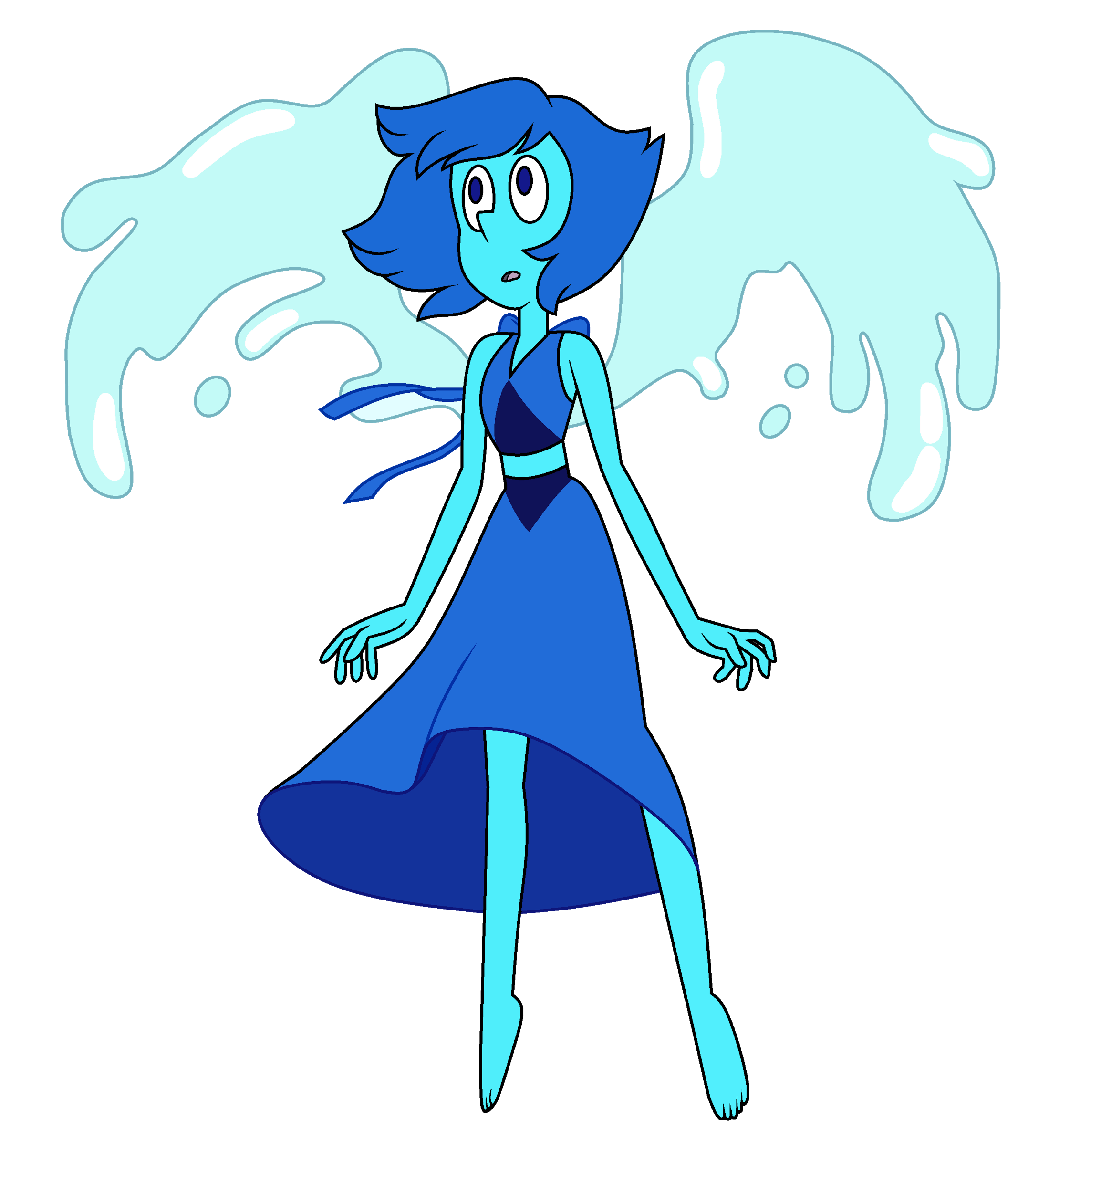
AR Validations - presence
Indicates that a value must be present
# app/models/person.rb
class Person < ActiveRecord::Base
validates :name, presence: true
end
# db/migrate/YYYYMMDDHHMMSS_create_people.rb class CreatePeople < ActiveRecord::Migration def change create_table :people do |table| table.string :name, null: false end end end

Slide 28
AR Validations - presence
# w/o model validation
[1] pry(main)> person = Person.create
=> ActiveRecord::StatementInvalid: PG::NotNullViolation: ERROR: null value in column "name" violates not-null constraint
# w/ model validation for presence
[1] pry(main)> person = Person.create
=> #<Person:0x007fa74cb44128 id: nil, name: nil, created_at: nil, updated_at: nil>
[2] pry(main)> person.errors
=> #<ActiveModel::Errors:0x007fa74cb3f4c0
@base=#<Person:0x007fa74cb44128 id: nil, name: nil, created_at: nil, updated_at: nil>,
@messages={:name=>["can't be blank"]}>
[3] pry(main)> person.errors.full_messages
=> ["Name can't be blank"]

Slide 29

AR Validations - uniqueness
Indicates that a value must be unique for all records
# app/models/author.rb
class Author < ActiveRecord::Base
validates :name, uniqueness: true
end
# db/migrate/YYYYMMDDHHMMSS_add_unique_index_for_author_names.rb class AddUniqueIndexForAuthorNames < ActiveRecord::Migration def change
add_index :authors, :name, unique: true
end end

Slide 30
AR Validations - uniqueness
# w/ model validation for uniqueness
[1] pry(main)> king = Author.create(name: "Stephen King")
=> #<Author:0x007f9c6ca91e00
id: 1,
name: "Stephen King",
created_at: 2016-06-07 14:24:06 UTC,
updated_at: 2016-06-07 14:24:06 UTC>
[2] pry(main)> king_again = Author.create(name: "Stephen King")
=> #<Author:0x007f9c6b1aa1f8 id: nil, name: "Stephen King", created_at: nil, updated_at: nil>
[3] pry(main)> king_again.errors.full_messages
=> ["Name has already been taken"]

Slide 31

AR Validations - numericality
Indicates that a value must be a number
# app/models/book.rb
class Book < ActiveRecord::Base
validates :pages,
numericality: { only_integer: true, greater_than: -1 }
end
# db/migrate/YYYYMMDDHHMMSS_add_pages_to_books.rb class AddPagesToBook < ActiveRecord::Migration def change
add_column :books, :pages, :integer, default: 0
end end

Slide 32
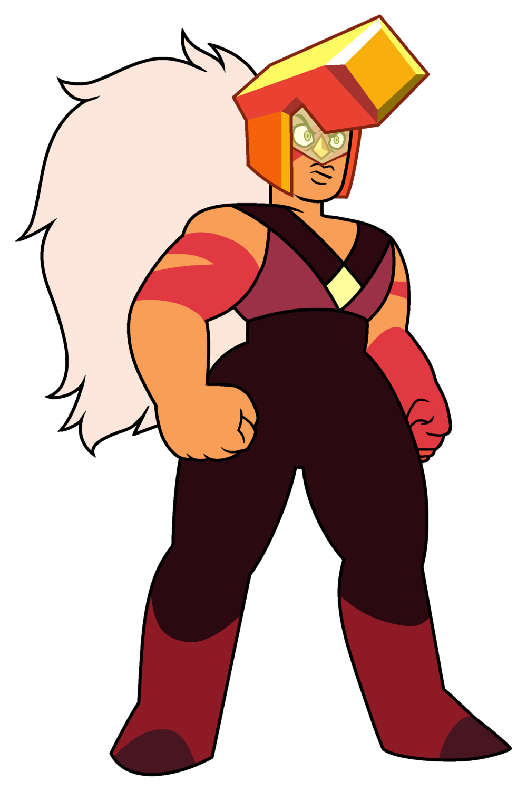
AR Validations - format
Value must match the provided regular expression (regex)
# app/models/person.rb
class Person < ActiveRecord::Base
validates :email,
format: { with: /@/, message: "must be a valid email address" }
end
# db/migrate/YYYYMMDDHHMMSS_add_email_to_people.rb class AddPagesToBook < ActiveRecord::Migration def change
add_column :people, :email, :string
end end

Slide 33

Obligatory xkcd Comic
xkcd.com/1171
Notes:
Replace “Perl”, with “Ruby”, and you have the same number of problems

Slide 34

AR Validations - format
Value must match the provided regular expression (regex)
# app/models/person.rb
class Person < ActiveRecord::Base
# source: http://stackoverflow.com/a/7168125/2675670
validates :blog_link, format: {
with: URI::regexp(["http", "https"]), message: "must be a valid URL"
}
end
# db/migrate/YYYYMMDDHHMMSS_add_blog_link_to_people.rb class AddBlogLinkToPeople < ActiveRecord::Migration def change
add_column :people, :blog_link, :text
end end

Slide 35

AR Validations - inclusion
Value must be included in a set
# app/models/person.rb
class Person < ActiveRecord::Base
ROLES = ["user", "moderator", "admin"]
validates :role, inclusion: { in: ROLES }
end
# db/migrate/YYYYMMDDHHMMSS_add_role_to_people.rb class AddRoleToPeople < ActiveRecord::Migration def change
add_column :people, :role, :string, default: "user"
end end

Slide 36

ActiveRecord - custom validations!
When nothing fits the bill, roll your own...
# app/models/person.rb
class Person < ActiveRecord::Base
validate :name_must_start_with_the_letter_r
def name_must_start_with_the_letter_r
unless name.first.downcase == "r"
errors.add(:name, "is not RAD enough to use this app")
end
end
end

Slide 37

That’s some magic. Go find more.

